Slide 1

Whole Foods Restaurant
A data analysis presentation for a new location
in Los Angeles County
By Antranik Kolanjian
1/21/2019

Slide 2
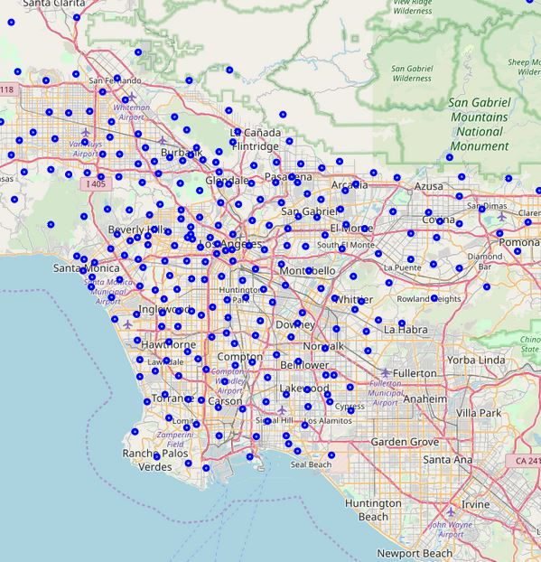
Table of contents
Introduction
Data
Methodology
Results
Conclusion

Slide 3
introduction
Whole Foods would like enter the fast casual restaurant business somewhere within the Los Angeles County
Criteria:
Lots of foot traffic
High median household income
Health conscientious population
Not too much competition
Types of food would include organic pizzas, sandwiches, salads, etc
Very rich and diverse population and restaurants in Los Angles.

Slide 4
data
Total of 241 Zip Codes in Los Angeles County
Used US Census Bureau data to determine:
Population Density by Zip Code
Median Household Income Zip Code
Foursquare API
Used to determine types of venues and most common venues in all 241 Zip Codes.
Zip Codes were used because there could be multiple Zip Codes in any particular neighborhood. It’s better data for LA County.

Slide 5
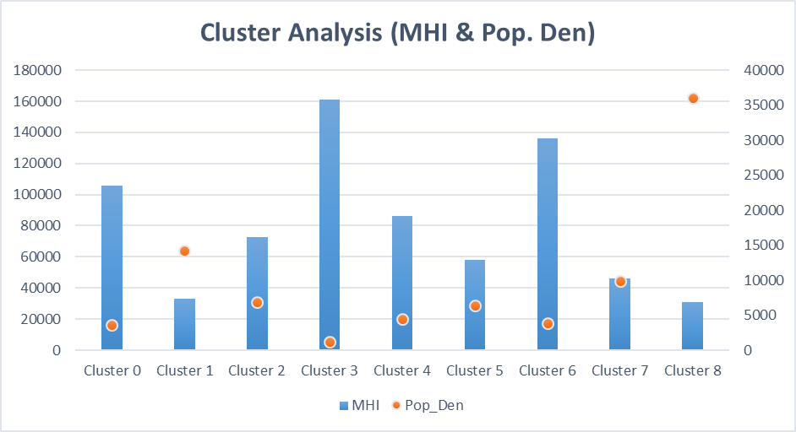
Methodology
Consists of Kmeans and One-hot encoding methods of:
High Median Household Income
Population
Population Density
Foursquare Data via API

Slide 6
results
2 clusters were identified based on Median Household Income and Population Density.
Same clusters were analyzed for most common venues within each cluster.
Three Zip Codes were identified
Hermosa Beach
Santa Monica
Porter Ranch
Hermosa Beach had the highest Median Household Income with the highest Population Density numbers that was also the healthiest town with the least amount of competition.

Slide 7
Discussion/Observations
Reccomendation is to start out at Hermosa Beach, but more research should be done on foot to pick out the best spot. However, it should definitely be a beach town for the following reasons:
Kmeans Cluster method on Population Density with Median Household income clustered many of the beach towns together. Confirming our suspicion that wealthier people are living closer together(condos) as long as it’s in a beach town.
The wealthy people either live next to each other on the beach or in very sparsely populated towns. They are much younger and health conscious in the beach towns.

Slide 8
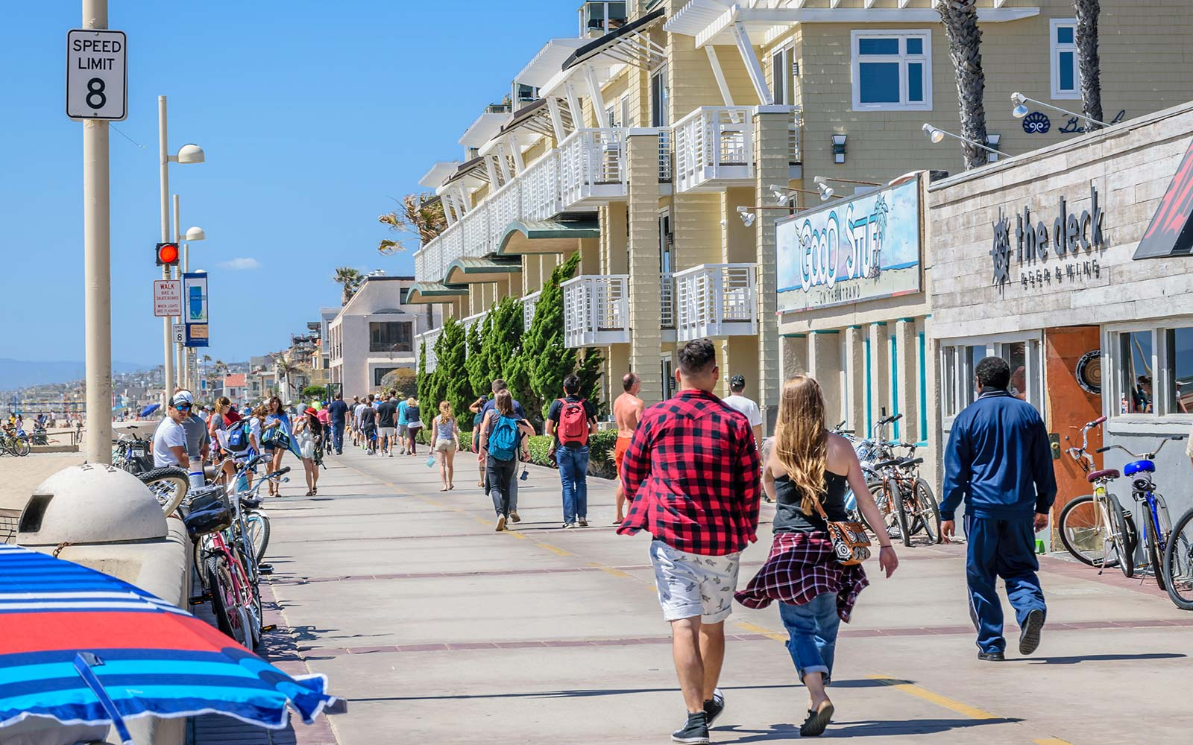
Conclusion
Hermosa Beach, CA
Healthy
Wealthy
Densely Populated
Manageable Competition
GREAT OPPORTUNIY AWAITS FOR WHOLE FOODS

